Slide 1


Thesis Defense On
Breaking the Misinformation Barrier: A Comparative Study of Machine Learning and Deep Learning Approaches to Fake News Detection
Presented By:
Supervised By:
Rubel Sheikh
Lecturer, Educational Technology and Engineering BDU
Student Name | Student ID
Md. Tarif Mahmud | 1902007
Mst. Hanium Maria | 1902012

Slide 2
TABLE OF CONTENT
01
Introduction
05
Proposed Methodology
06
Experimental Result
02
Objectives
07
Conclusion & Future Work
03
Literary Review
Contribution
08
References
04

Slide 3
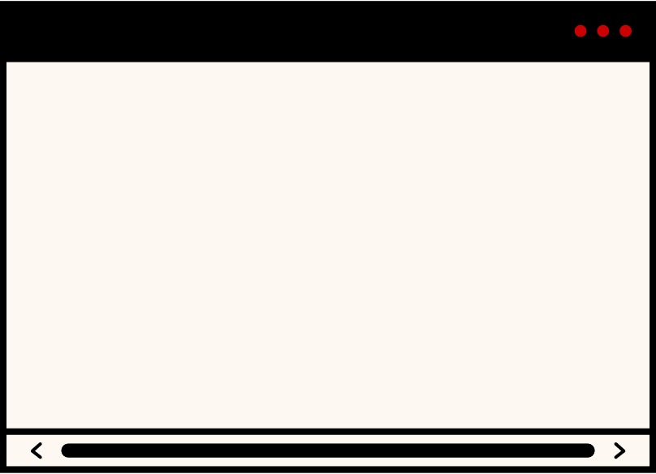

INTRODUCTION
The spread of Fake news is a big problem. It affects people’s views and trust. Traditional ways of detecting fake news aren’t working anymore, so we need to use modern technology.
The study evaluates various Machine Learning Models (Random Forest, Logistic Regression, Naive Bayes, Passive Aggressive Classifier) to identify the most accurate approach.
LSTM with Word2Vec and fine-tuned BERT were used for better context understanding.
Explainable AI techniques like LIME are used to interpret and increase the transparency of model predictions.

Slide 4


Objectives
To assess the performance of ML and DL models in fake news detection on public dataset
To explore the challenges of detecting fake news
To explore the integration of multiple approaches for fake news detection
To improve transparency in fake news detection models using Explainable AI (XAI)

Slide 5
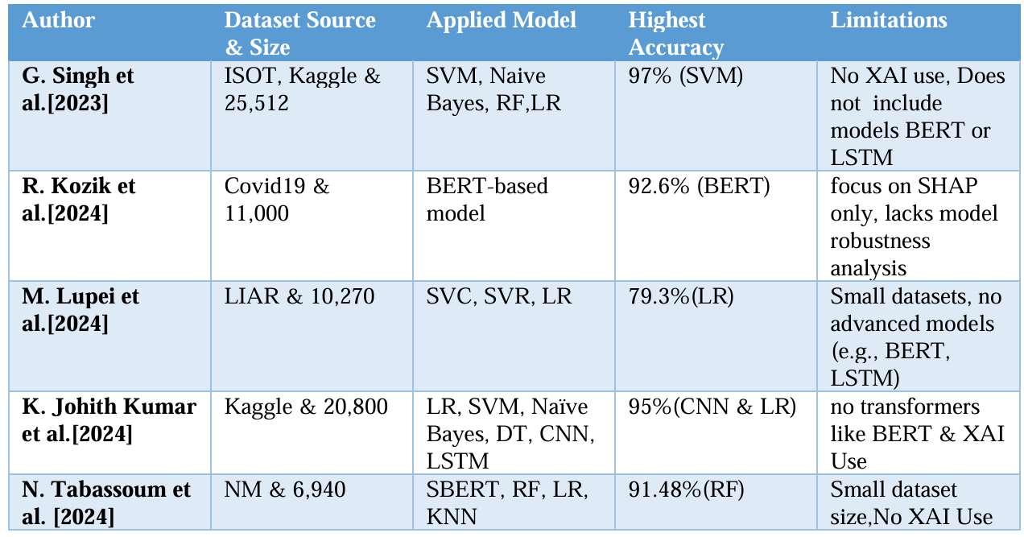
Literature Review

Slide 6

Contribution
Integrated Approach
Data Preprocessing
We combine ML, DL, and XAI techniques to improve fake news detection.
We cleaned the data by removing unnecessary elements like HTML tags and stop words, making it ready for analysis
Model Application
Improved Transparency
We applied various models like Random Forest, Logistic Regression, LSTM, and BERT to detect fake news
Using LIME, we made the model's predictions more understandable by showing which words influenced the results.

Slide 7

Dataset Description
Our dataset is taken from a Kaggle dataset of 44,916 news articles.
These articles are divided into two categories: 23,497 labeled as fake news and 21,419 labeled as real news.
The dataset contains five main features for each article, namely title, text, subject, level and date.

Slide 8
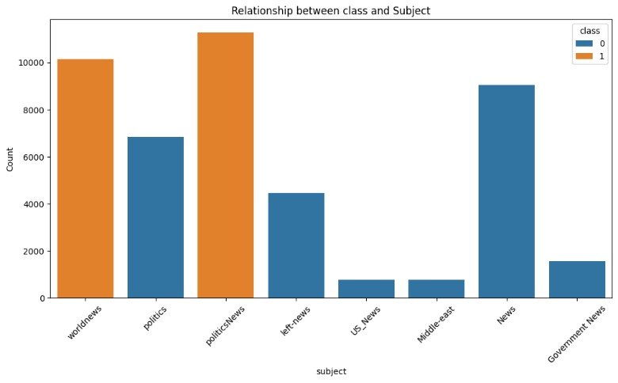
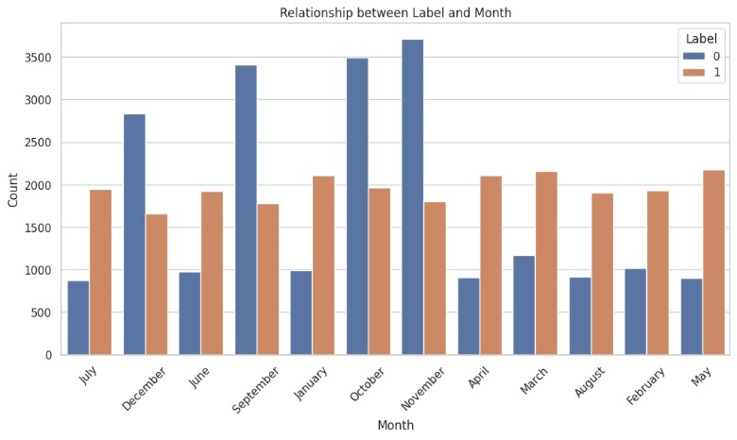
Dataset Description(Contd.)
Fig: Relationship between Class and Subject
Fig: Relationship between Label and Month

Slide 9
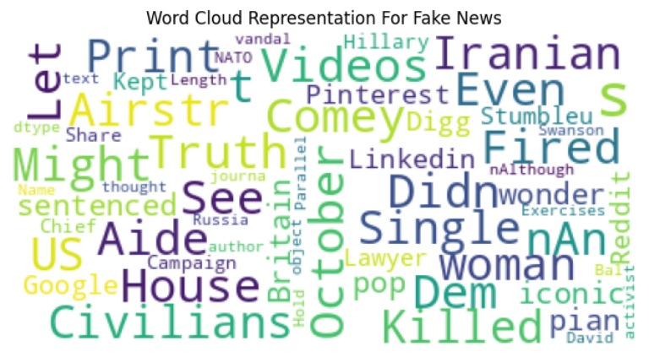
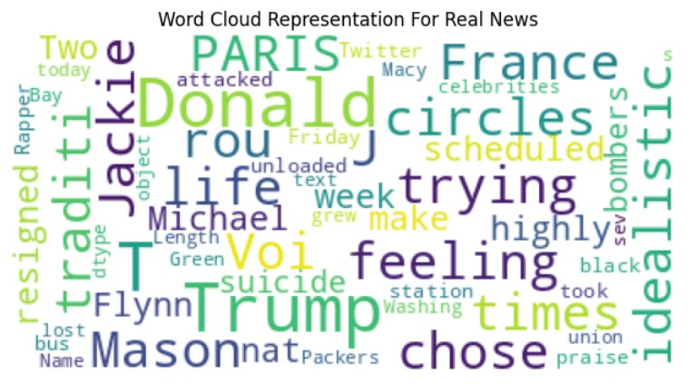
Dataset Description(Contd.)

Slide 10
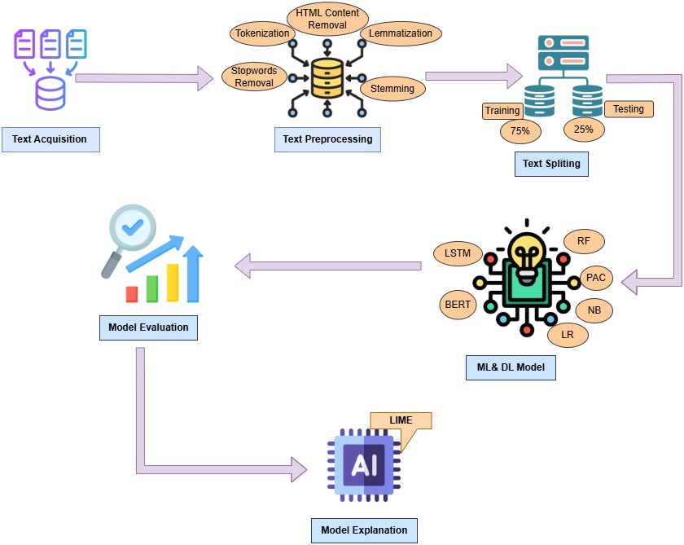
Methodology
Working Procedure to Predict Fake news

Slide 11
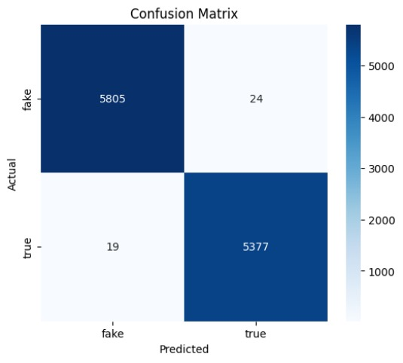
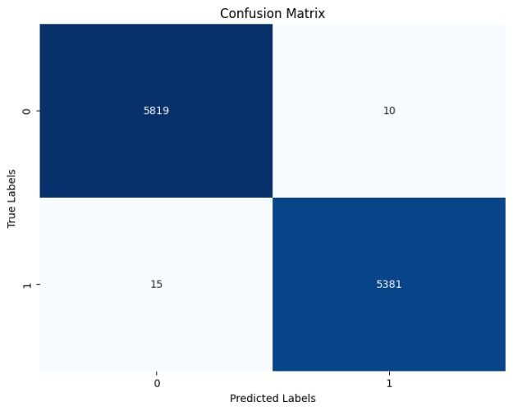
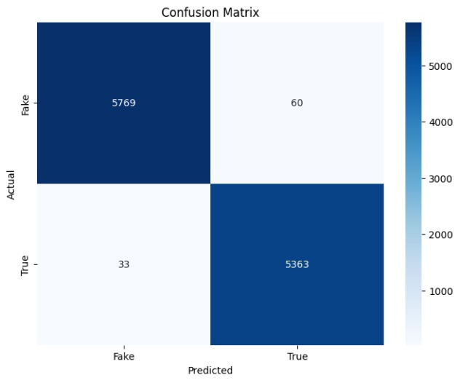
Confusion Matrix
Figure: Confusion Matrix of Logistic Regression
Figure: Confusion Matrix of Passive Aggressive Classifier
Figure: Confusion Matrix of Random Forest

Slide 12
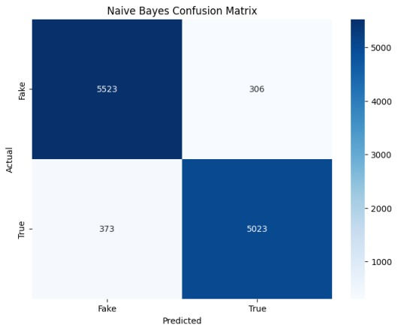

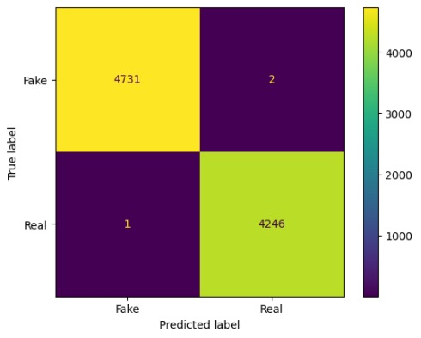
Confusion Matrix(Contd.)
Figure: Confusion Matrix of Naive Bayes
Figure: Confusion Matrix of LSTM
Figure: Confusion Matrix of BERT

Slide 13
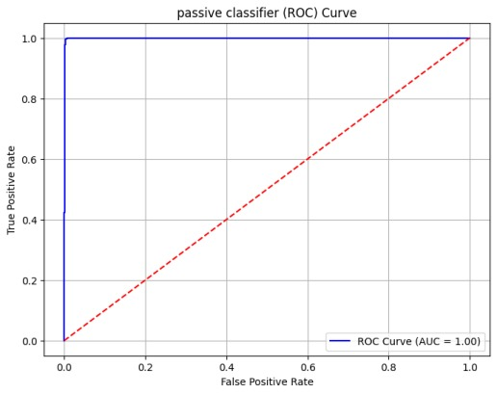
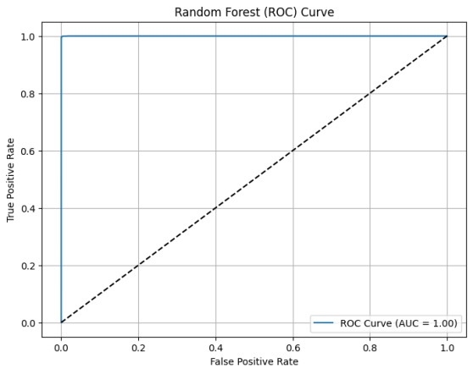
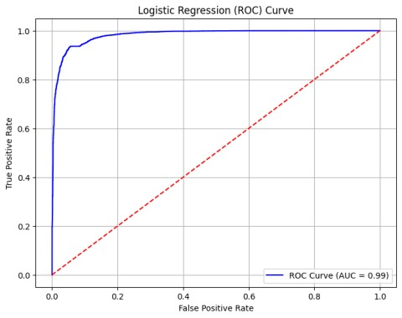
ROC Curve
Figure : ROC Curve for PAC
Figure : ROC Curve for RF
Figure: ROC Curve for LR

Slide 14
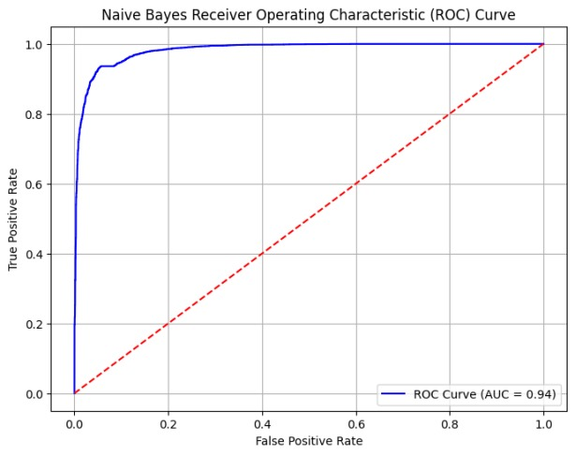
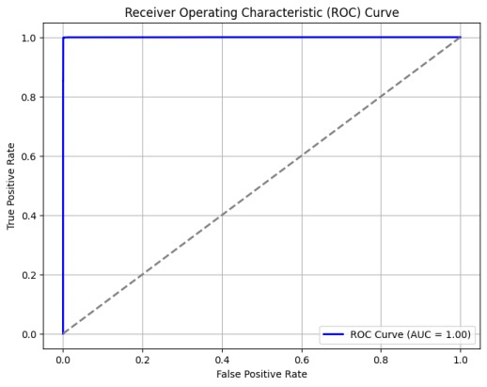
ROC Curve(Contd.)
Figure : ROC Curve for NB
Figure : ROC Curve for LSTM
Figure: ROC Curve for BERT

Slide 15
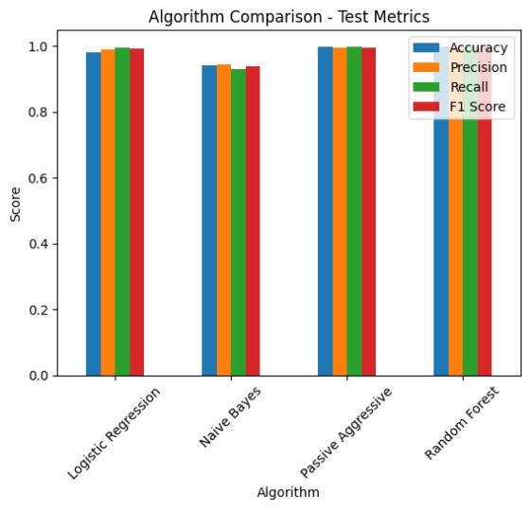
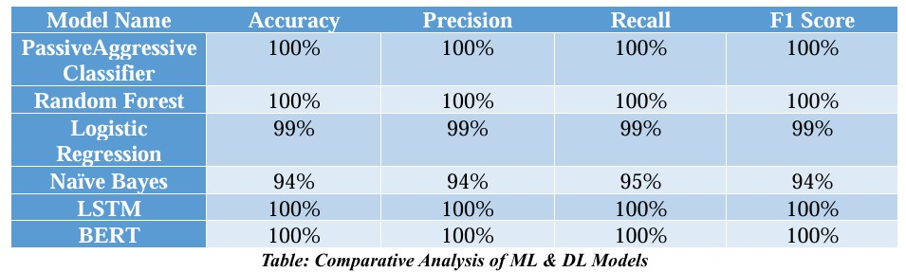
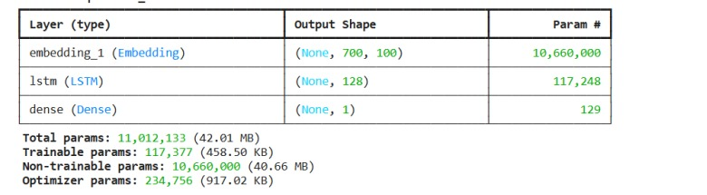
RESULT
Figure: Overall Comparison of Four ML Models Evaluation Metrics
Figure : Model Summary of LSTM

Slide 16
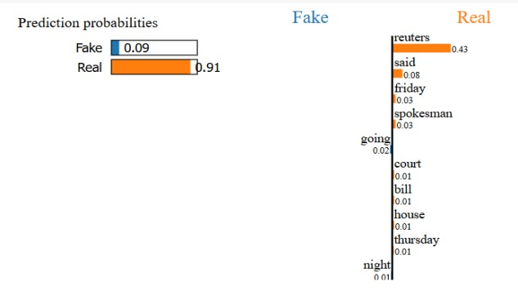
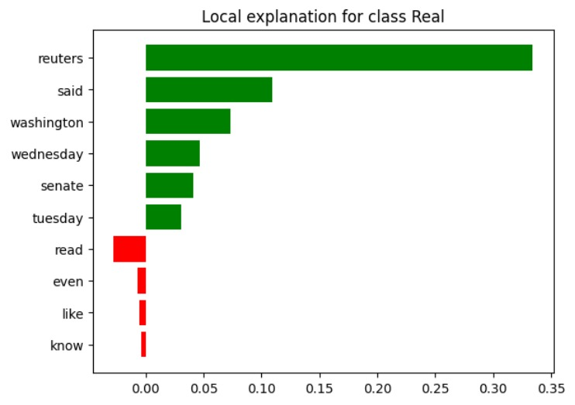
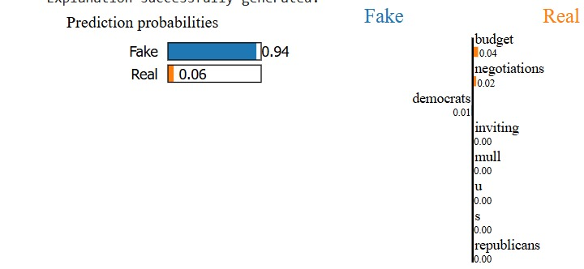
RESULT(LIME)
Explainable AI (XAI) enhances transparency and trust by making machine learning model decisions understandable to human. In fake news detection, LIME explains why a model labels news as fake or real by highlighting key features or words, ensuring transparency and trust.
Figure: : LIME explanations for prediction probabilities for both classes(Real & Fake)
Figure: Top Influential Words for Classifying News as Real Using LIME Explanation

Slide 17
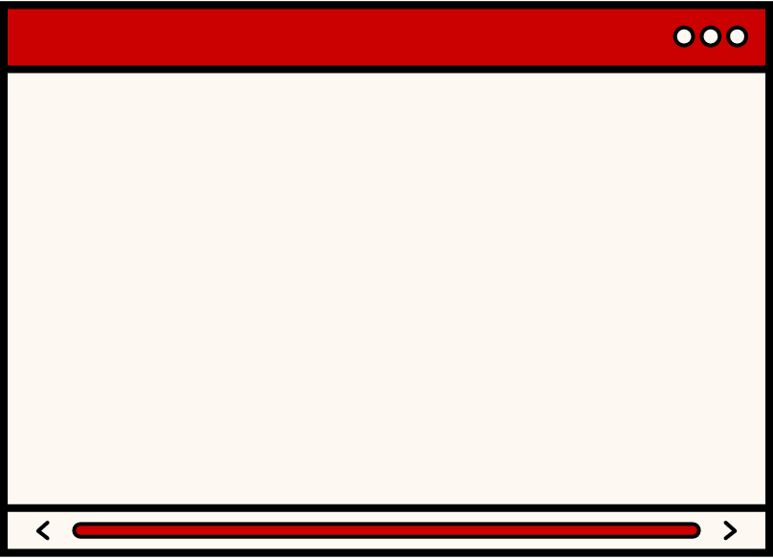
CONCLUSION
Our research successfully demonstrates the detection of fake news using ML, DL, and XAI techniques, achieving an impressive 100% accuracy. Models such as Random Forest, Passive Aggressive Classifier, LSTM, and BERT delivered outstanding performance in classification tasks. The incorporation of XAI methods like LIME ensured transparency, interpretability, and trust in the model's decisions
BDU | Educational Technology & Engineering | 2025

Slide 18


Future Work
Exploration of Multimodal Detection Approaches.
Development of Cross-Lingual and Cross-Cultural Detection.
Advancements in Real-Time Detection.
Integration of Fake News Detection with Social Media Platforms.
Utilization of User Behavior Analysis for Fake News Detection.
BDU| EdTE| 2025

Slide 19
References
https://researchguides.uoregon.edu/fakenews/issues/defining
https://libguides.uvic.ca/fakenews/consequences
R. Kozik, M. Ficco, A. Pawlicka, M. Pawlicki, F. Palmieri, and M. Choraś, “When explainability turns into a threat-using xai to fool a fake news detection method,” Computers & Security, vol. 137, p. 103599, 2024
Kumar, K. J., Shreya, K., Divakarla, L. P., Nair, P. C., & Sampath, N. (2024, June). Interpretable AI Insights in Fake News Detection: A Comparative Analysis of CNN and LSTM. In 2024 15th International Conference on Computing Communication and Networking Technologies (ICCCNT) (pp. 1-6). IEEE.
N. Tabassoum and M. A. Akber, “Interpretability of machine learning algorithms fornews category classification using xai,” in 2024 6th International Conference on Electrica lEngineering and Information & Communication Technology (ICEEICT). IEEE, 2024,pp. 770–775.

Slide 20

THANK YOU
SO MUCH!
BDU| EdTE | 2025

